Slide 1

Notes:
PLEASE DO NOT DELETE THIS SLIDE. PER COMPLIANCE THE DISCLAIMERS NEED TO BE ON ALL PRESENTATIONS.

Slide 2


My name is, Brett Stacy and I am the National Director & Founder of Operation T.A.G. (Tangible Act of Gratitude), a 501(c)(3) Non-Profit Project of the High Desert Community Foundation.
MISSION STATEMENT:
Operation T.A.G.™ (Tangible Act of Gratitude) is committed to giving military families more than appreciation—we deliver tangible, life-changing support.
Through our nonprofit program, The Hometown Hero Credit™, and in partnership with our trusted mortgage partner PRMG, we provide real financial assistance, education, and resources that help service members, veterans, and Gold Star spouses achieve homeownership and long-term financial security.
Brett Stacy
National Director & Founder of Operation T.A.G., a Project of the High Desert Community Foundation

Slide 3


When “Thank you”
is not enough

Slide 4
It’s Time For More Than “Thank you”.
After the Gulf Wars and 911, a wave of patriotism swept over the country. “Thank you for your service” became a “feel-good” way for average people to show their support. This was a great starting point, but after 25 years, nothing's changed.
Our American Soldiers write out a blank check made out to the United States of America (you & me) in the amount of, and including, their lives. Is “Thank you for your service” truly, the best we can do? I believe we all should do more to recognize their service and sacrifice.
Don’t you agree?

Slide 5
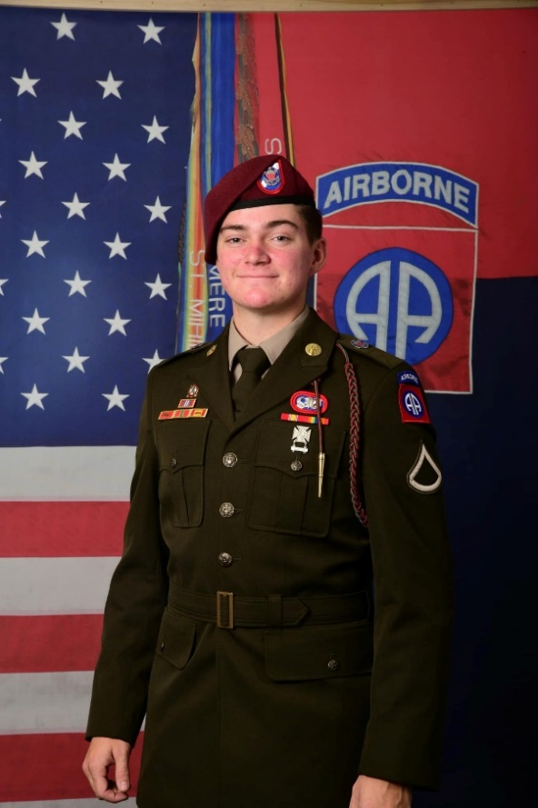
Proud Army Dad
As a Proud Army Dad, I know firsthand how difficult it is for our nation’s heroes to save enough to purchase a home. With a VA loan:
No down payment needed
No mortgage insurance
VA Funding Fee (if applicable) included in the loan
However, there are THOUSANDS of dollars that must be paid out-of-pocket in closing fees. The Hometown Hero Credit was developed to alleviate this obstacle to homeownership.

Slide 6
OPERATION T.A.G.
Hometown Hero Credit

Slide 7
Our Heroes Deserve More
Operation T.A.G. (Tangible Act of Gratitude) and its flagship program, the Hometown Hero Credit are 501(c)(3) Non-Profit Programs of the High Desert Community Foundation. We have partnered with PRMG to provide veterans, and active-duty members with a 2% credit, up to $21,000 to help pay closing fees, buy down the already low interest rate, or pay real estate agent commissions.
NO repayment is needed
NO second mortgage
NO income restrictions (Higher income earners qualify)
NO increase in the interest rate
AVAILABLE in 49 states

Slide 8
LET’S COMPARE
Homes for Heroes
Hometown Hero Credit

Slide 9

Homes for Heroes
Everyone’s heard of “Homes for Heroes”. On a $500,000 home purchase, this is what their website says a military family member will receive in benefits.

Slide 10
Hometown Hero Credit
When a veteran or active-duty member purchases a home selling for $500,000, and a loan amount of $500,000, The Hometown Hero Credit will provide 2% in assistance (up to $21,000) or in this example, $10,000.00 that can be used to help pay closing fees, buy down the already low interest rate or pay real estate agent commissions. It’s up to the hero to decide how they want to use their credit.
Where does the money come from, you might be thinking? PRMG gives back THE MAJORITY of their profit as a tangible act of gratitude, putting gratitude over company profits.

Slide 11
Summary ($500k VA Purchase)
Homes for Heroes:
$4,200.00 in benefit
30% reduction in Realtor commission
Optional participation from lender
Yearly fee to participate in the program
Landing page, marketing and leads provided
Hometown Hero Credit:
$10,000.00 in benefits
0% reduction in Realtor commission
PRMG gives the Tangible Act of Gratitude
ZERO cost or obligation to participate in program
Landing page, marketing and leads provided

Slide 12
Become a Brand Ambassador
Help us to spread the word about this much needed, and well-deserved program. As a Brand Ambassador of Operation T.A.G. and the Hometown Hero Credit, you’ll receive:
1. Fully Branded Landing Page complete with your photograph and contact information
2. An Autoresponder where leads / contacts go directly to you
3. Done-For-You Social Media Marketing and Flyers
4. When we prequalify someone for a home purchase and they do not have a Realtor, we refer them to our Ambassadors
*100% FREE!!! – For us, it’s not about making money, it’s about making a difference.

Slide 13
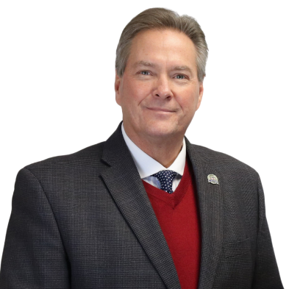


Contact Us!
Brett Stacy
National Director & Founder
Hometown Hero Credit Program
Operation T.A.G. (Tangible Act of Gratitude)
A 501(c)(3) Non-Profit Project of the HDCF
Bstacy@OperationTAG.org / 760.490.4094
Scott Stacy
National Director & Co-Founder
Hometown Hero Credit Program
Operation T.A.G. (Tangible Act of Gratitude)
A 501(c)(3) Non-Profit Project of the HDCF
Sstacy@OperationTAG.org / 760.596.7537

Slide 14

It’s time we ALL did more than simply say,
“Thank You For Your Service”
Notes:
PLEASE DO NOT DELETE THIS SLIDE. PER COMPLIANCE THE DISCLAIMERS NEED TO BE ON ALL PRESENTATIONS.

