Slide 1

Notes:
Hello everyone! It’s a great day to honor the service & sacrifice of our nations heroes. Don’t you agree?

Slide 2


My name is, Brett Stacy and I am a 20-year veteran of the mortgage industry. I’ve closed hundreds of loans and still managed to remain married 40 year to the love of my life. I have 3 beautiful children and 6 wonderful grandchildren. I’m a 42-year resident of Southern California’s High Desert.
Published Author of 7 Books:
”Living Life by Design”
”Lessons From A Life Well Lived”
”The Reverse Mortgage Roadmap”
”Reverse Mortgage Confidential…The Naked Truth”
”Let’s Talk Reverse Mortgages”
”Million Dollar Loan Officer”
”How to FIRE Your Landlord & Buy Your Own Home”
Certifications / Licenses:
Ex Professional Tennis Player
Life Coach / Goal Success Coach
Local Pastor’s License
Brett Stacy
National Brand Ambassador Hometown Hero Credit Program
Notes:
My name is Brett Stacy and I’m the Founder & National Brand Ambassador for Operation T.A.G. (Tangible Act of Gratitude) and PRMGs National Corporate Initiative, the Hometown Hero Credit Program. I’m a 20-year veteran of the mortgage industry. I love to write books…7 so far and 2 more in the works.

Slide 3
Our Brand Ambassadors:
Every movement worth following begins with heart — and for me, that heart begins at home.
My oldest son, Scott Stacy, is not only the Co-Founder, but also our National Success Coach and Team Lead. Scott embodies the mission of Operation T.A.G. (Tangible Act of Gratitude) — turning gratitude into action and leadership into legacy. He’s on the front lines of helping other loan officers, agents, and partners across the country understand what it means to serve those who’ve served us.
My youngest son, Bradley Stacy, is our Active-Duty Brand Ambassador. He currently serves our nation proudly in the United States Army at Joint Base Lewis-McChord in Washington State, as part of a Special Forces support team serving alongside our Green Berets.
As his father — and as a proud Blue Star family member — I can tell you there are few honors greater than watching your child raise their right hand and swear an oath to defend our nation.
I’m an Army Dad, through and through.
I love this country — not just in word, but in the quiet pride that fills my chest every time I hear The Star-Spangled Banner.
Brett Stacy
National Brand Ambassador Hometown Hero Credit Program
Notes:
We have two additional Brand Ambassadors. My oldest son Scott is the co-founder, National Brand Ambassador, & Team Lead for the program. My youngest son Bradley is our Active-Duty Brand Ambassador and is currently serving his country in the United States Army at Joint Base Lewis McChord in the state of Washington. He’s part of a Special Forces team that supports the Green Berets. I’m one very proud Army Dad. I love being a Blue Star family member and needless to say, I love our country.
When I hear our national anthem, I proudly stand. When I sing our national anthem, I’m not embarrassed to say, I often cry. When I see our American flag, the red stands out. I think of the blood that has been spilled. The lives lost. I think of my son when he enlisted at 18 years old, basically writing a blank check made out to the United States of America, that’s to you and me, in the amount of, up to and including, his life. I think about when the time comes for him to end his military career and begin the next phase of his life, will he, like so many veterans today, face chronic pain, heart disease, or cancer. Will he struggle with physical trauma or traumatic stress issues…PTSD, depression, anxiety or even suicide. Nearly 18 veterans a day die from suicide.

Slide 4
Our Reason Why:
When I hear our national anthem, I stand tall.
When I sing it, I don’t hide my tears.
And when I see our American flag wave, it’s the red that catches my eye first — a reminder of the blood that’s been spilled and the lives laid down for the freedoms we enjoy every single day.
I think of my son at eighteen — pen in hand, signing a blank check payable to the United States of America (that’s you and me), for an amount up to and including his life.
That’s what service means.
That’s what sacrifice looks like.
But I also think about what comes after service — the battles many of our heroes still fight once the uniform comes off. The invisible wounds of PTSD, depression, anxiety, and loss that claim far too many lives.
Every single day, nearly 18 veterans die by suicide.
Eighteen brave men and women who gave everything for this nation — and felt they had nothing left to live for.
That’s why Operation T.A.G. exists.
That’s why Hometown Hero Credit™ .
Because gratitude without action is just a feeling.
And our nation’s heroes deserve more than feelings —
they deserve a future.
Brett Stacy
National Brand Ambassador Hometown Hero Credit Program
Notes:
We have two additional Brand Ambassadors. My oldest son Scott is the co-founder, National Brand Ambassador, & Team Lead for the program. My youngest son Bradley is our Active-Duty Brand Ambassador and is currently serving his country in the United States Army at Joint Base Lewis McChord in the state of Washington. He’s part of a Special Forces team that supports the Green Berets. I’m one very proud Army Dad. I love being a Blue Star family member and needless to say, I love our country.
When I hear our national anthem, I proudly stand. When I sing our national anthem, I’m not embarrassed to say, I often cry. When I see our American flag, the red stands out. I think of the blood that has been spilled. The lives lost. I think of my son when he enlisted at 18 years old, basically writing a blank check made out to the United States of America, that’s to you and me, in the amount of, up to and including, his life. I think about when the time comes for him to end his military career and begin the next phase of his life, will he, like so many veterans today, face chronic pain, heart disease, or cancer. Will he struggle with physical trauma or traumatic stress issues…PTSD, depression, anxiety or even suicide. Nearly 18 veterans a day die from suicide.

Slide 5


When “Thank you”
is not enough
Notes:
So, how do adequately thank those who have willingly sacrificed so much to protect the freedoms we so often take for granted?

Slide 6
It’s Time For More Than “Thank you”.
After the Gulf Wars and 9/11, a powerful wave of patriotism swept across our nation. Everywhere you went, people began saying, “Thank you for your service.” It became our nation’s go-to phrase — a way for everyday Americans to express appreciation to those who wore the uniform.
And that was a beautiful start.
But here we are, more than 25 years later, and the words haven’t evolved into something more. The movement that began with gratitude… has stalled at the surface.
Saying “thank you” will never be enough for those who signed a blank check to the United States of America — payable up to and including their lives.
I believe it’s our responsibility — yours and mine — to do more than speak our gratitude. We must live it. We must act on it.
Each of us has the power — and the obligation — to find our own way to transform heartfelt appreciation into tangible action that truly honors the men and women who’ve sacrificed so much for us.
Because real gratitude isn’t just something
you say…It’s something you do.
Don’t you agree?
Notes:
In the late 1990’s and especially after 911, a wave of patriotism swept over the country. Saying, “Thank you for your service” became fashionable. That was a great start, but it’s been over 25 years, and the movement hasn’t progressed. I believe it’s our responsibility (individually) to do what we can, to honor our nation’s heroes in a tangible way. Each of us, in our own way need to find a way to turn our heartfelt gratitude into action. Don’t you agree?

Slide 7
OPERATION T.A.G.
Hometown Hero Credit
Notes:
So, for me, as a 20-year veteran of the mortgage industry, I felt I could make a difference here. In 1999 Scott & I introduced Operation T.A.G. (Tangible Act of Gratitude) and its flagship program, The Hometown Hero Credit. We’ve helped hundreds of military families become homeowners. In the process we’ve given away close to $1 million dollars. Our Dream was to take this program nationally so we could help military families across the country become homeowners. Chris Sorensen, National Retail Director of PRMG, and the company founders, Paul Rozo & Robert Holliday loved our program, embraced our passion, and agreed to take our program nationally and make it available to all PRMG loan officer across the country.

Slide 8
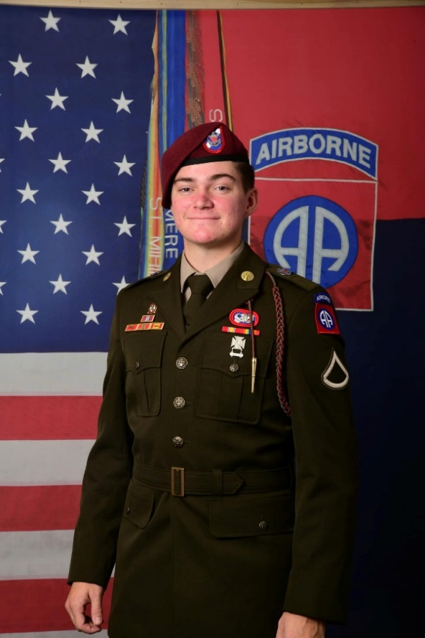
Our HEROES Deserve More
Operation T.A.G. (Tangible Act of Gratitude) and its flagship program, the Hometown Hero Credit provide veterans, and active-duty members with a 2% credit (of the loan amount), up to $21,000 to help pay closing fees, buy down the already low interest rate, or pay real estate agent commissions.
NO repayment is needed
NO second mortgage
NO income restrictions (Higher income earners qualify)
NO increase in the interest rate
AVAILABLE in 49 states
Notes:
That’s my hero, my son, Brad! Read from slide.

Slide 9
LET’S COMPARE
Homes for Heroes
Hometown Hero Credit
Notes:
If you google “Veteran mortgage benefits” or “Military benefits when buying a home” you’ll get thousands & thousands of results. You’ll see beautifully constructed websites with American Flags, smiling military families, and official looking language. 98% of what you find is junk, scams or marketing. It’s unfortunate. Our military families deserve better.
There is another popular program that you might of head of called, Homes for Heroes. And, as I compare the two programs please know that I’m not “Bashing” Homes for Heroes. Any program that gives real benefit to military families I’m all in for. I just happen to think our program offers much, much more value to the service member and a real estate agent. So let’s compare the two.

Slide 10

Homes for Heroes
Everyone’s heard of “Homes for Heroes”. On a $500,000 home purchase, this is what their website says a military family member will receive.
Notes:
If you click on the Homes for Heroes website, they have this tool that estimates your benefit from using one of their certified real estate agents and loan officers. For a $500,000 home purchase, a service member can expect to receive $4,200.

Slide 11
Hometown Hero Credit
When a veteran or active-duty member purchases a home selling for $500,000, with a loan amount of $500,000, The Hometown Hero Credit will provide 2% in assistance (up to $21,000) or in this example, $10,000.00 that can be used to help pay closing fees, buy down the already low interest rate or pay real estate agent commissions. It’s up to the hero to decide how they want to use their credit.
Where does the money come from, you might be thinking? We give back THE MAJORITY of our profit as a tangible act of gratitude, putting gratitude over company profits.
Notes:
If the service member used the Hometown Hero Credit program, they would receive $10,000 that they could use to pay closing fees, buy down the already low interest rate, or even pay real estate agent commissions.

Slide 12
Summary ($500k VA Purchase & Loan Amount)
Homes for Heroes:
$4,200.00 / Buyer receives a 1099
30% reduction in Realtor commission
Optional participation from lender
Yearly fee to participate in the program
Landing page, marketing and leads provided
Hometown Hero Credit:
$10,000.00 / NO 1099
0% reduction in Realtor commission
PRMG gives 100% participation
ZERO cost or obligation to participate in program
Landing page, marketing and leads provided
Notes:
So, let’s take a deep dive and compare the two programs. Read from the slide.

Slide 13
Become a Brand Ambassador
Becoming a Brand Ambassador for Operation T.A.G. (Tangible Act of Gratitude) isn’t about titles, perks, or paychecks — it’s about purpose. It’s about joining a national movement that believes our military families deserve more than words — they deserve gratitude in action.
As a Brand Ambassador, you’re not just representing a program — you’re carrying a message. You’re helping to shine a light on the real heroes among us: the men and women who’ve worn our nation’s uniform and the families who’ve stood behind them. By sharing their stories, spreading awareness, and helping connect them to programs like Hometown Hero Credit™ and Red, White & Secure™, you become a living example of what gratitude looks like in motion.
You don’t have to be a lender, a realtor, or even connected to the mortgage industry to make a difference. All it takes is heart — and the belief that “Thank you for your service” should come with something tangible attached. Together, we can help one military family at a time experience what it truly means when a nation says,
“We haven’t forgotten you.”
Notes:
We are inviting you today to Build a Business. Build a Legacy. Make a Difference. 100% Free. As a Brand Ambassador for this incredible program we provide you with:
1. Fully Branded Landing Page complete with your photograph and contact information
2. An Autoresponder where leads / contacts go directly to you
3. Done-For-You Social Media Marketing and Flyers
4. When we prequalify someone for a home purchase and they do not have a Realtor, we refer them to our Ambassadors
And again, the best part of the program is it’s absolutely free to join. Why? Because we believe our nations heroes deserve more than “Thank you for your service” when buying a home. We’re putting heartfelt gratitude over profits.

Slide 14


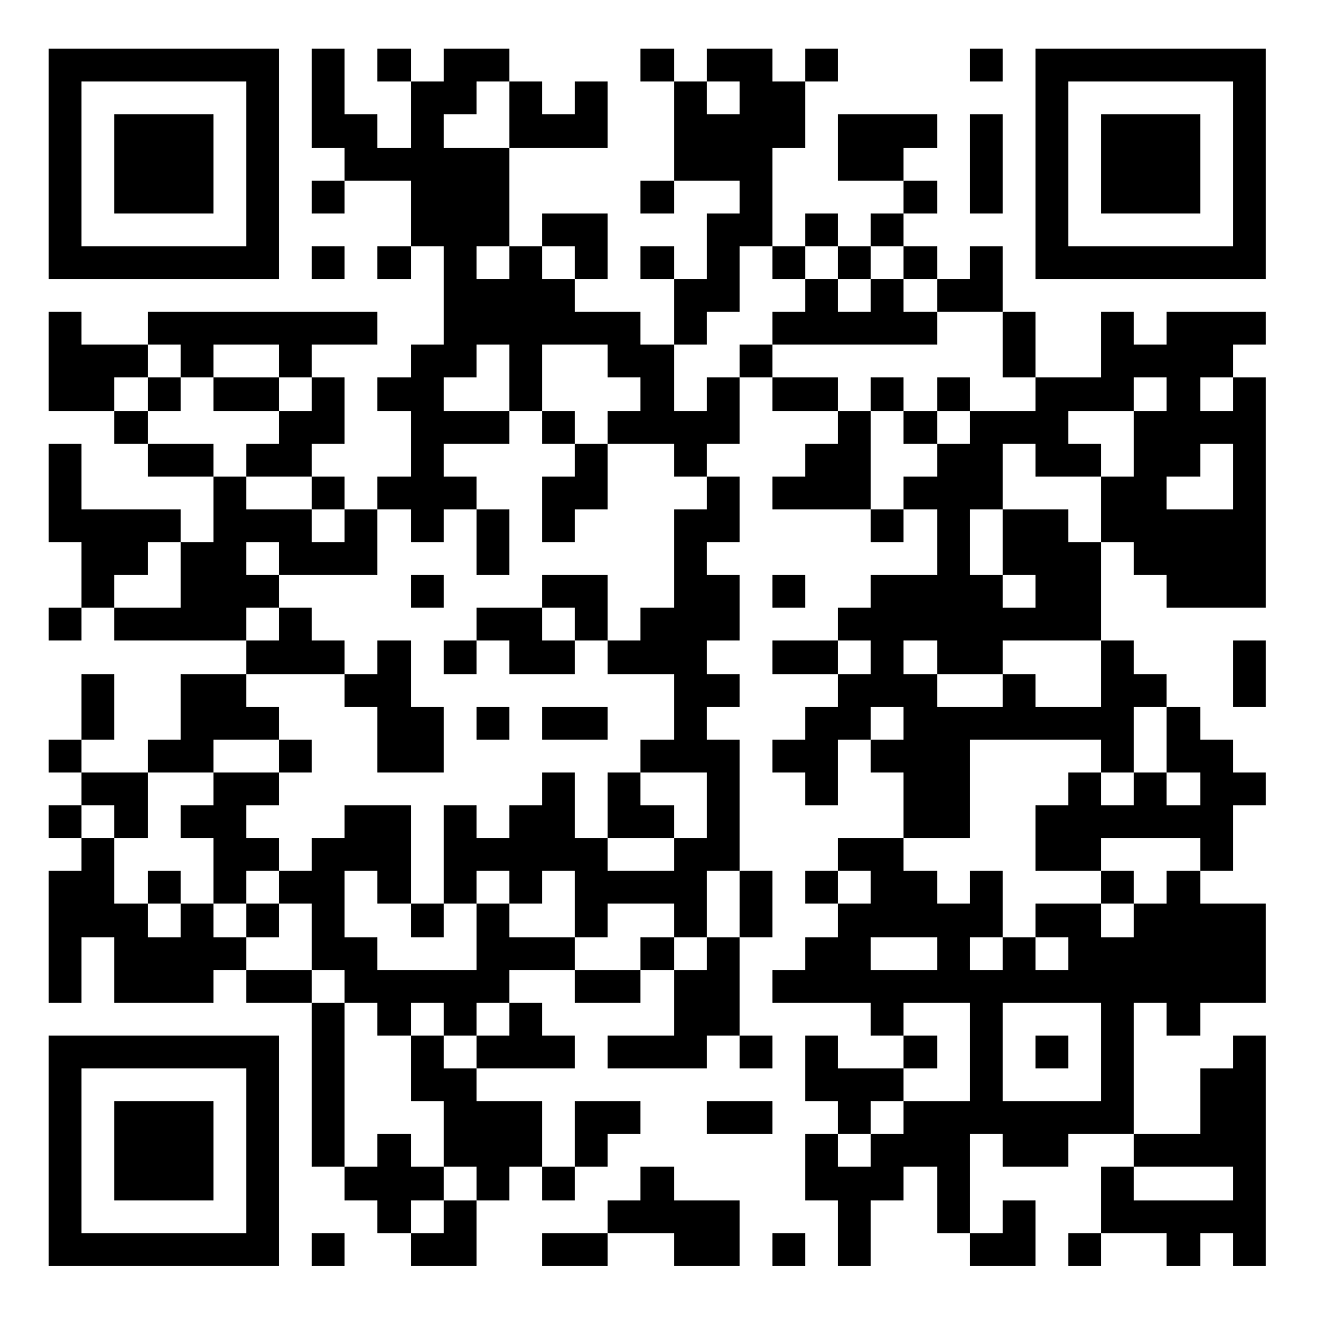
Contact Us!
Brett Stacy
Director, National Brand Ambassador
Hometown Hero Credit Program
Paramount Residential Mortgage Group
Bstacy@PRMG.net / 760.490.4094
Scott Stacy
National Brand Ambassador
Hometown Hero Credit Program
Paramount Residential Mortgage Group
Sstacy@PRMG.net / 760.596.7537
Notes:
If you’d like join our National Movement, reach out to the PRMG loan officer that invited you to this presentation or click on the QR code and you’ll be directed to a Google Form that will walk you through what we need to get you started.

Slide 15

Notes:
The Hometown Hero Credit…REAL support. REAL impact. REAL heartfelt gratitude. Helping to make homeownership a reality for military families across the country.

Slide 16

It’s time we ALL did more than simply say,
“Thank You For Your Service”
Notes:
Come join the movement…click on the QR code to get started.

